Slide 1
Compilers Presentation
בס"ד
(Noah and Yair)+

Slide 2


Goob stuff
בס"ד

Slide 3
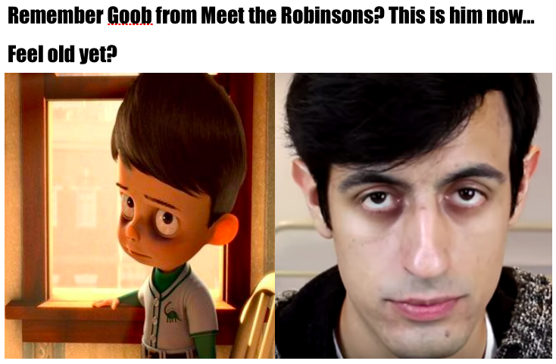
Goob stuff
בס"ד

Slide 4
Warning: These slides may be asynchronous a.k.a. nodejs
בס"ד

Slide 5
Problem(s) wanted to solve
בס"ד
Find a cure for cancer.
Solve the Earth’s problems.
Bring Moshiach.

Slide 6
Problem Actually solved
בס"ד
Good question
Created a way to extract and update certain information from a website based on our terms.

Slide 7
DSL created
בס"ד
GoobScraper is the name
Can do a few things:
Retrieve html from a website
parse that html and to find any tables (or other things)
Extract the modified html/text to a local file
Automatically Update the file every now and then
Alert the user to any changes that occurred during updates.
Automatic updater must be run on its own – has its own main method.

Slide 8
Examples from DSL
בס"ד
/get url https://helpful-helium.glitch.me/;
Retrieves the HTML from this website.
A variable is returned: in this case the variable’s reference point/name is “0”.
/get table 0;
Extract all tables from the HTML that is currently in the variable 0.
Update the HTML in 0 to be the tables.
/extract new "shevatimTable.csv“;
The HTML in the last variable, in this case 0, should be extracted to a file called “ShevatimTable.csv”.
The “new” keyword indicates that any data in “ShevatimTable.csv” should be overwritten.
/quit
Exit the program.

Slide 9
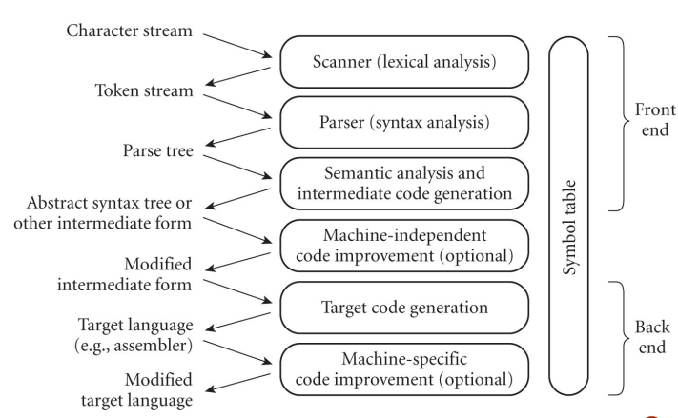
Steps in Compiling
בס"ד

Slide 10
ANTLR – What is ANTLR?
בס"ד

Slide 11
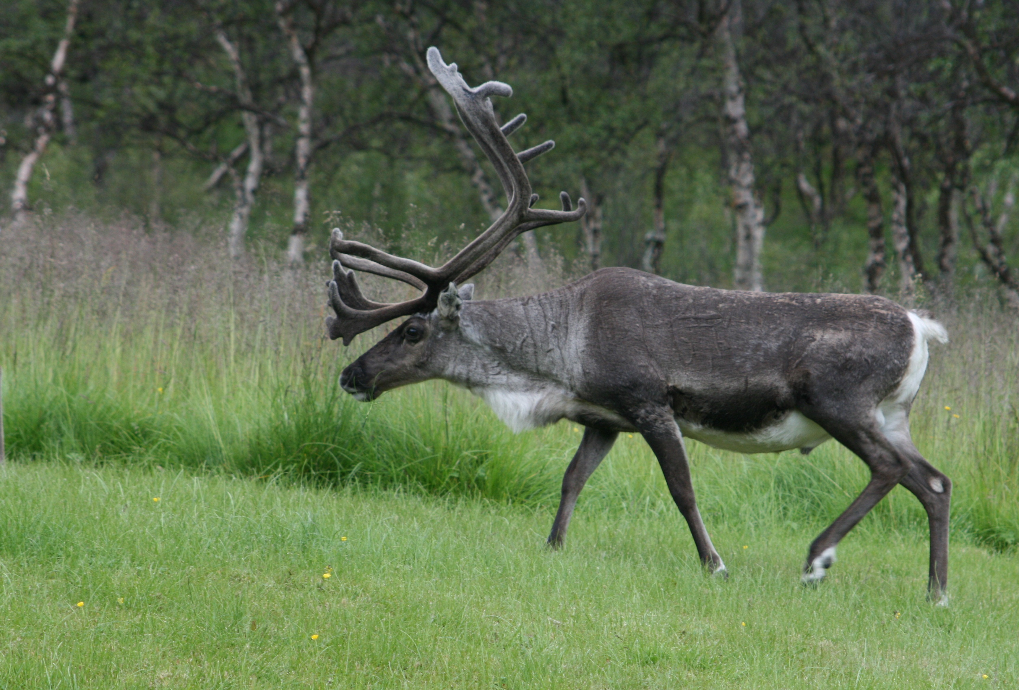
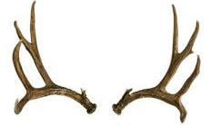
Option #1
בס"ד

Slide 12

Option #2
בס"ד

Slide 13

Option #3
בס"ד

Slide 14
In English words, more or less
בס"ד
Generates a Parser using a given language
And a Parsetree
Now can walk through the tree using visitors and listeners

Slide 15

In English words, more or less
בס"ד
Then walk manually or use a tree walker to (sprint and) react to stuff through a visitor or listener.
Programs

Slide 16
In English words, more or less
בס"ד
Specific languages, such as:
Java, Python
JS, Go
Maybe in the future: English, Hebrew, and Japanese

Slide 17
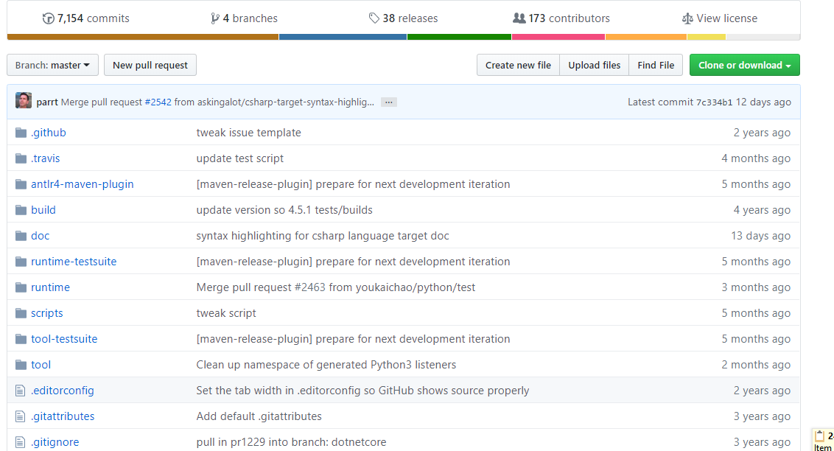
ANTLR
בס"ד
ANother Tool for Language Recognition
From the GitHub repository:
https://github.com/antlr/antlr4

Slide 18

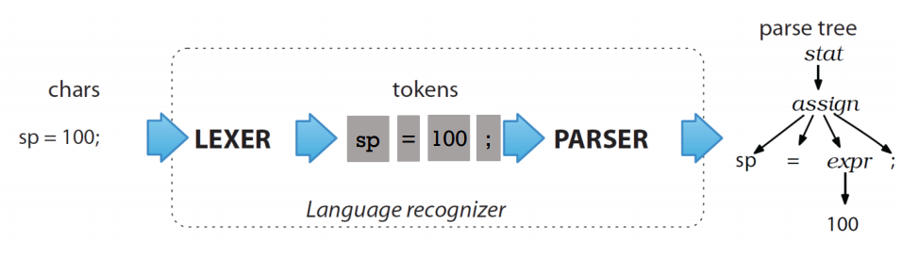
ANTLR Steps
בס"ד
ANTLR runs the Lexer to split the grammar into tokens, and then runs the Parser to create a ParseTree from which one can implement a visitor and/or a listener.

Slide 19
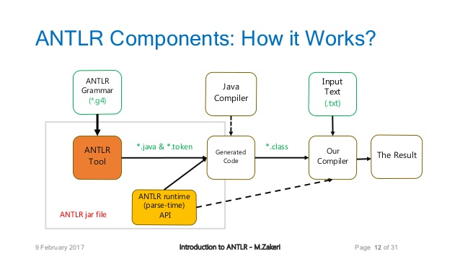
How ANTLR works
בס"ד

Slide 20
Example
בס"ד
Using

Slide 21
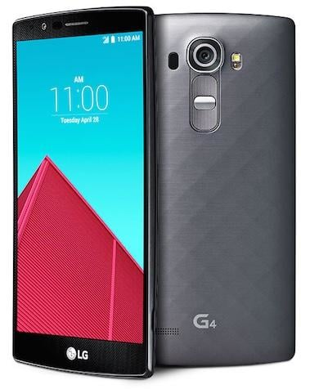
בס"ד
In the .g4 file:
Notes:
Three steps:
Enter - listener
Do a little הקפה – Visitor (does something)
Exit - listener

Slide 22
Used by the Lexer:
בס"ד
STRING : '"' (~[\r\n"])* '"';
ID : [A-Za-z]+ ;
NUMBER : [0-9]+ ;
WS : [ \n\t\r]+ -> skip;
Notes:
Three steps:
Enter - listener
Do a little הקפה – Visitor (does something)
Exit - listener

Slide 23
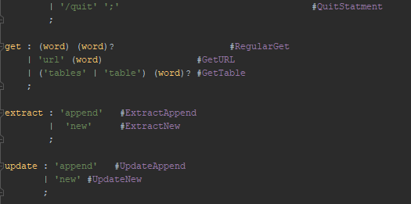
Used by the Parser
בס"ד

Slide 24
Lexer – background and data structures
בס"ד
- Recognizes and split tokens
Internal ANTLR:
nextToken() method (parameter is a charStream and an int) which calls match()
Match() either calls matchATN() or calls execATN()
matchATN() – creates the DFA, which holds DFAStates
execATN() – matches the input stream
nextToken() – just to return a Token

Slide 25
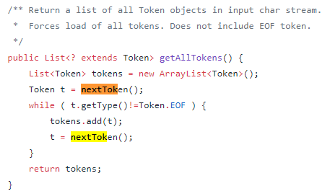
Lexer – background and data structures
בס"ד
Uses a charStream for storing the input (either grammar of the language (ANTLR) or the code)
Uses an arraylist to store and return all the Tokens.

Slide 26
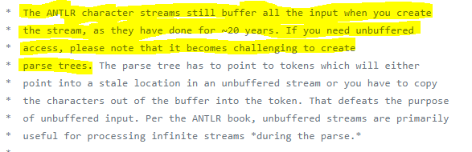


In the CharStreams class
בס"ד

Slide 27
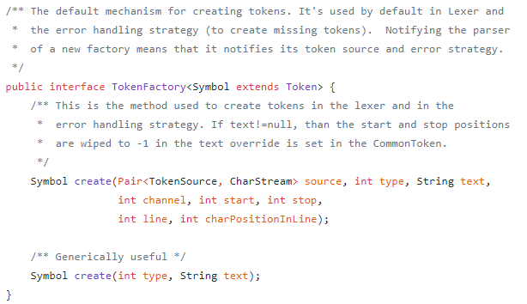
Create Tokens – Token object just holds the info
בס"ד

Slide 28
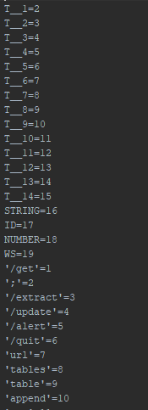
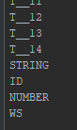
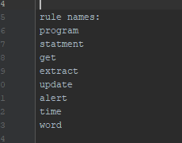
Little detour: GoobScraper.tokens →
בס"ד
Finds all literal names, such as “/get”.
Finds the symbolic names, such as “STRING”.
Each token is assigned a number.
The array lengths of “token literal names”, “token symbolic names”, and “rule names” are all the same length, with “null” or “T_something” filling in the empty slots.
In the lexer, the “rule names” are: STRING, ID, NUMBER, and WS and references to the literal names:
(All that the lexer cares about
are the literals and just splitting
Up the tokens. The Lexer does
not care about putting the words
together into sentences.)
After the lexer → In the parser, the “rule names” will be:
(The Parser needs to know what the rules are so that they
can be the parent node in the parse tree.)

Slide 29
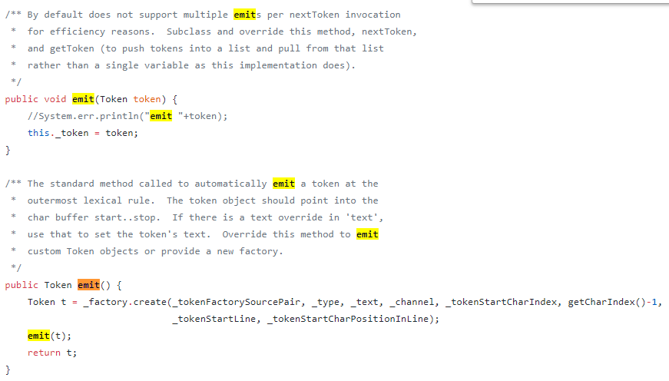
Emit() –what the lexer calls to call the token factory
בס"ד

Slide 30
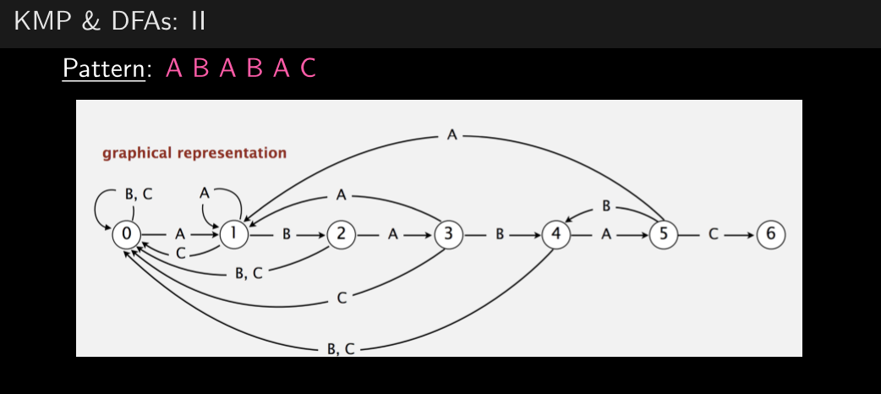
Lexer - algorithm
בס"ד
From Leff’s slides

Slide 31
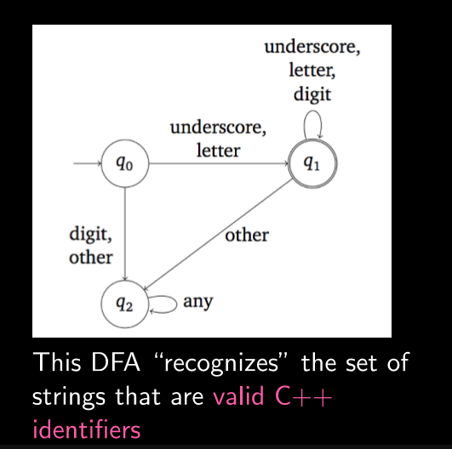
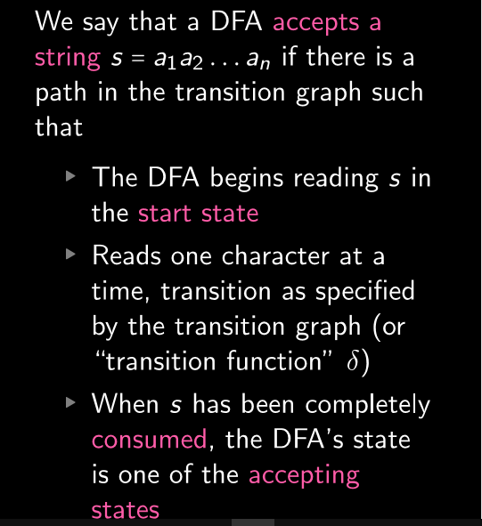
Lexer - algorithm
From Leff’s slides
בס"ד

Slide 32
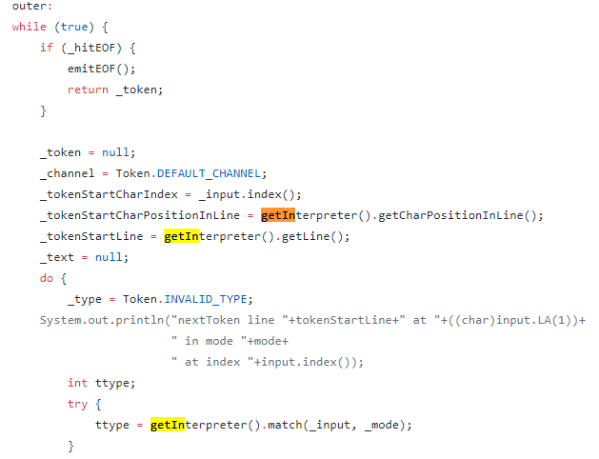
nextToken() Code Part 1/2
בס"ד

Slide 33
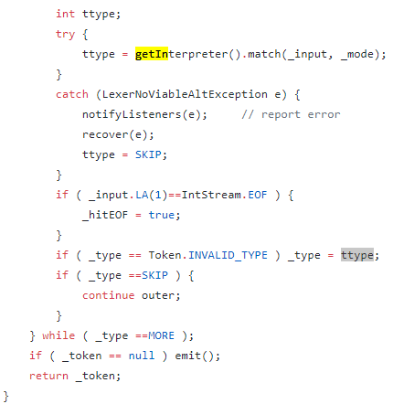
nextToken() Code Part 2/2
בס"ד

Slide 34
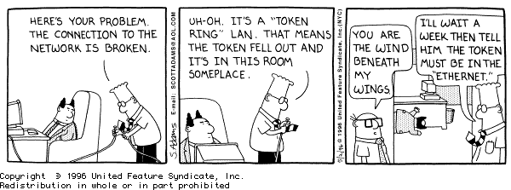
בס"ד

Slide 35
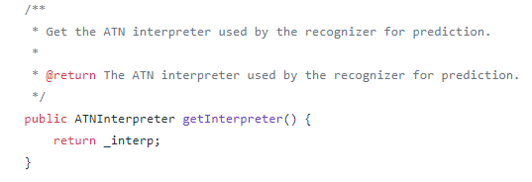
The elusive getInterpreter() method
בס"ד
Both the Lexer and the Parser extend the Recognizer
ATN = Augmented Transition Network = state machine

Slide 36
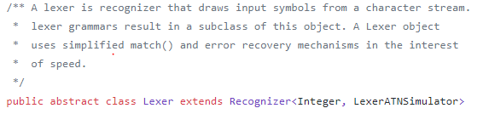
The elusive getInterpreter() method
בס"ד
The Lexer is an abstract class which extends recognizer and calls getInterpreter()

Slide 37
The elusive getInterpreter() method
בס"ד
The Parser is an abstract class which uses the getInterpreter as an ATNSimulator
ParserInterpreter class extends Parser

Slide 38
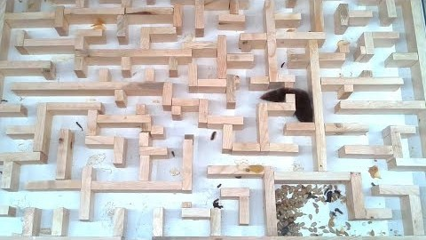
Parser: Maze == Tree - DFS
בס"ד

Slide 39
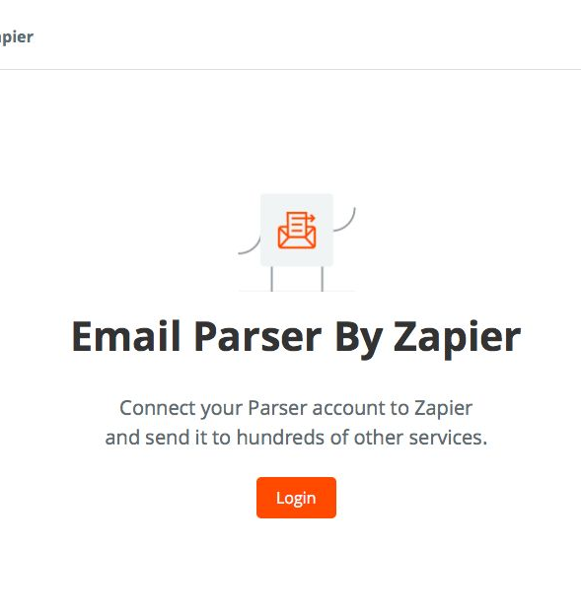
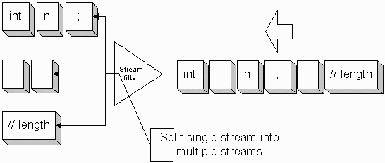
Parser - פרסר
בס"ד
The Lexer outputted a stream of tokens, so now the parser takes that stream and creates a parse tree with it.
Visitors and listeners on the parse tree

Slide 40
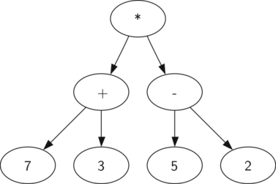
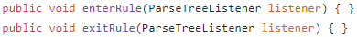
Parser – Data Structures
בס"ד
Tree
Uses ParserRuleContext, which extends RuleContext, objects as the nodes in the tree.
Also have enter and exit rules for the listener

Slide 41
Parser – Algorithms
בס"ד
Match()
if token is valid, then consume() is called, or else error stuff.
Uses an int (“type”) to compare and check if token is valid.
Consume()
Moves cursor to next token and adds child to tree, if not in error recovery

Slide 42
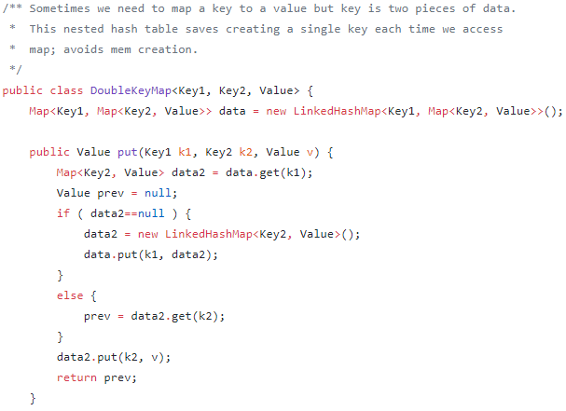
Cool: DoubleKeyMap
בס"ד

Slide 43
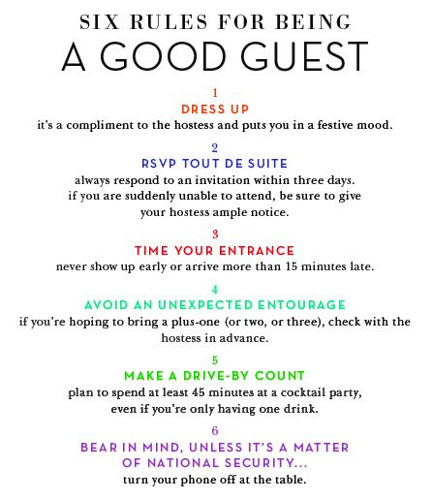

אורחים vs מלשינים:
בס"ד
VS.
Notes:
Three steps:
Enter - listener
Do a little הקפה – Visitor (does something)
Exit - listener

Slide 44



אורחים vs מלשינים:
בס"ד
They come with something
They “accept”
They settle in
They do something
They leave with something
VS.
“Enter”
“Exit”
Notes:
Three steps:
Enter - listener
Do a little הקפה – Visitor (does something)
Exit - listener

Slide 45

אורחים vs מלשינים: Video Example From the Simpsons
בס"ד
Notes:
Three steps:
Enter - listener
Do a little הקפה – Visitor (does something)
Exit - listener

Slide 46
בס"ד
After the Grammar (.g4 file) has been generated

Slide 47
Many classes generated:
בס"ד
GoobScraper.interp
GoobScraper.tokens
GoobScraperBaseListener
GoobScraperListener
GoobScraperBaseVisitor
GoobScraperVisitor
GoobScraperParser.java
GoobScraperLexer.java
GoobScraperLexer.interp
GoobScraperLexer.tokens

Slide 48
Let’s focus on 2:
בס"ד
GoobScraper.interp
GoobScraper.tokens
GoobScraperBaseListener
GoobScraperListener
GoobScraperBaseVisitor
GoobScraperVisitor
GoobScraperParser.java
GoobScraperLexer.java
GoobScraperLexer.interp
GoobScraperLexer.tokens

Slide 49
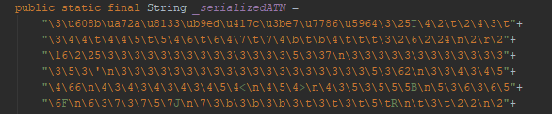
Similarities
בס"ד
private static String[] makeRuleNames()
private static String[] makeLiteralNames()
private static String[] makeSymbolicNames()
SerializedATN and deserializer method

Slide 50
Differences:
בס"ד
GoobScraperParser.java
GoobScraperLexer.java
- Enter, accept, and Exit
- States
*None*

Slide 51
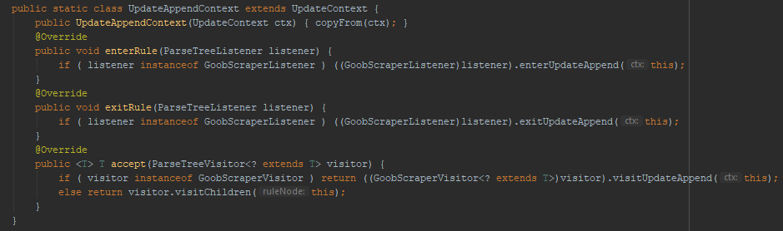
GoobScraperParser.java: Enter, accept, exit
בס"ד
enterRule() and exitRule(): listener
accept(): visitor
That is why there is type checking with instanceof

Slide 52
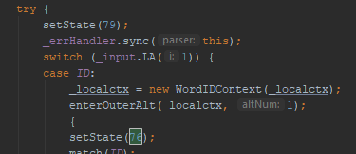
GoobScraperParser.java: States
בס"ד
Since a State Machine is used, so the state is constantly set with the setState() method call by the leaves in the parse tree as the tree is being traversed.

Slide 53
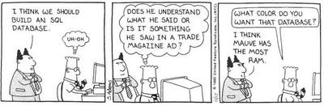
בס"ד

Slide 54

Class interactions
בס"ד
GoobScraperBaseListener and GoobScraperBaseVisitor are used to walk the parse tree.
We extend that class to TestGoobScraperVisitor and ListenerTestGoobScraper and wrote the program content there with overwriting the methods.

Slide 55
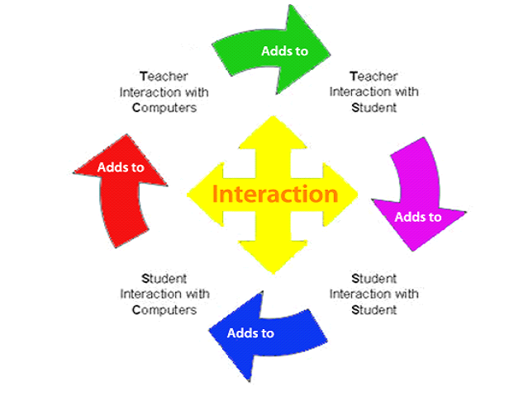
Class interactions
בס"ד
Now when a command comes in, the program automatically sends it to the correct method by first going to visit() in AbstractParseTreeVisitor.java which is the superclass of GoobScraperBaseVisitor.java, so the command is dynamically sent through.

Slide 56

Architecture of Goob
בס"ד
We have a Variable class which holds the html text, steps that already occurred, and other information until the program extracts and writes the information out to file and to the metadata file.
The automatic updater uses the information in the metadata file to redo the steps and update the files.

Slide 57
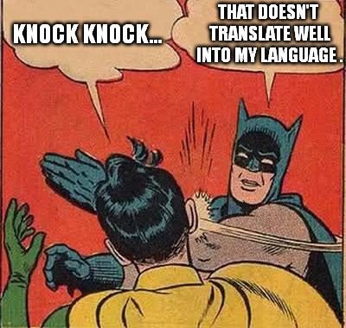
בס"ד

Slide 58
Comparison
בס"ד
CMD Interpreter
IDE
CMD translator
Pros
line by line, so easier debug
Can practice single lines of code, like JShell
Cons
Slower
Can’t translate whole pieces of code
Pros
A מחייה
Helps with writing code and avoiding simple syntax errors, like a missing semicolon
faster
Cons
Dr. Leff does not particularly like them
Issues with the IDE
Pros
translate/compile entire program/file into another language
faster
Cons
Either works or fails, so harder to fix
Better if can only use certain languages

Slide 59

בס"ד
Advantage with Translator

Slide 60
Commands in Goob
בס"ד
/get url url;
Retrieves html from webpage
/get table (variable)?
Gets all tables from the html and places the limited down html into the variable
/extract (new/append) (variable)? filename;
Extracts the current html inside the variable to a file
/update (new/append) (filename)? Time timetype;
/alert
Alerts the user during the updates
/quit
Exits program
Easier way than pressing the red button or ctrl+C

Slide 61
Next Steps in the project:
בס"ד
Option for Update and alert before extract
Web extension
Higher level algorithms for update
Better parsing for /get (regular)
/get table can recognize non-tables as well.

Slide 62
Summary of Goob project:
בס"ד
Defined DSL created to extract information from a website.
Implemented REPL and translator for the DSL using ANTLR
Runtime monitored source websites for changes and re-executed the user program to automatically retrieve updated data.

